Slide 1


Arctic Ice Management
Presenter: Kathryn Chamberlin
Johnathan Gamaunt, Professor Steven Desch, Professor Christopher Groppi, Professor Hilairy Hartnett

Slide 2
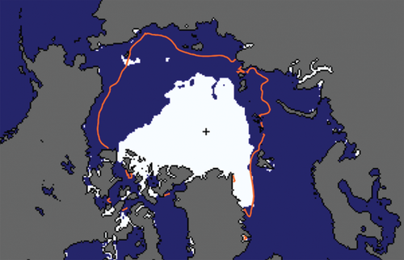
Motivation
End-summer ice in Arctic is predicted to be gone by 2030s¹
  Causes positive feedback in climate system
Goal: increase Arctic sea ice production by pumping sea water onto ice sheets during the winter
Image from the National Snow and Ice Data Center
¹Desch, S. et al. (2017), Arctic ice management. Earth's Future, 5: 107-127. doi:10.1002/2016EF000410

Slide 3
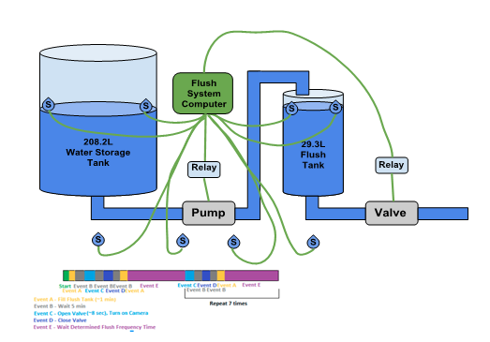
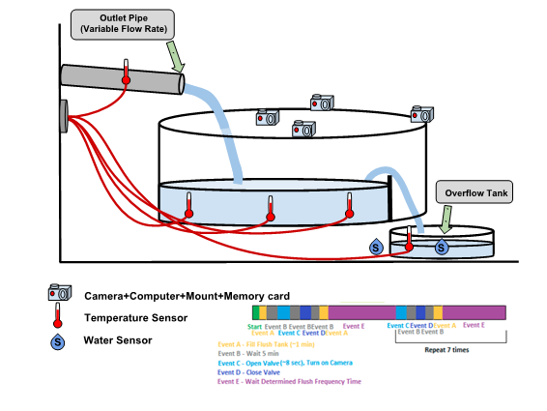
Concept of Operations

Slide 4
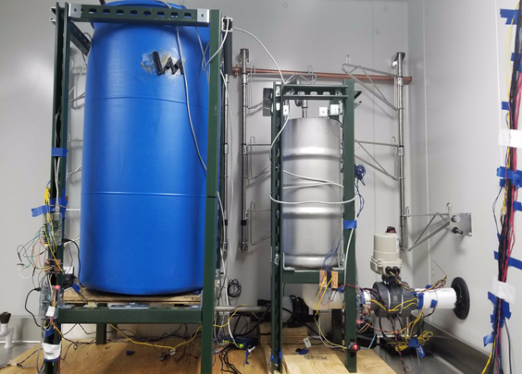
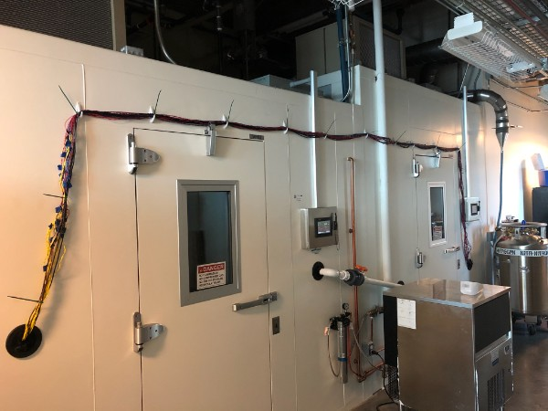
Test Apparatus
1
2
4
3
Refrigerator Setup
4ºC
55 gallon reservoir tank (1), 7 gallon flush tank (2), flush control valve (3)
3 separate computers
Refrigerator-Freezer Pass Through
Mass Flow Rate control valve (4)
Water sensor, temperature sensor, camera, and internet cabling

Slide 5
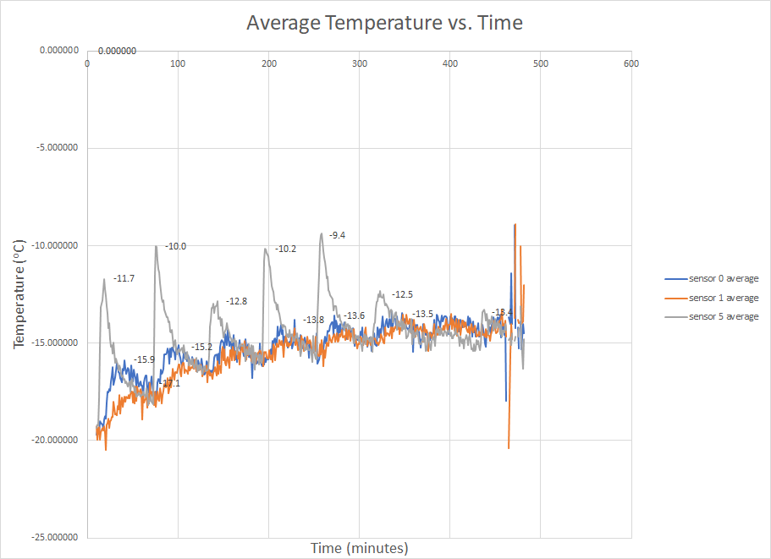
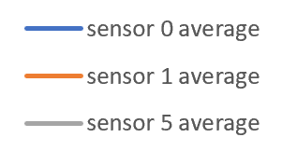
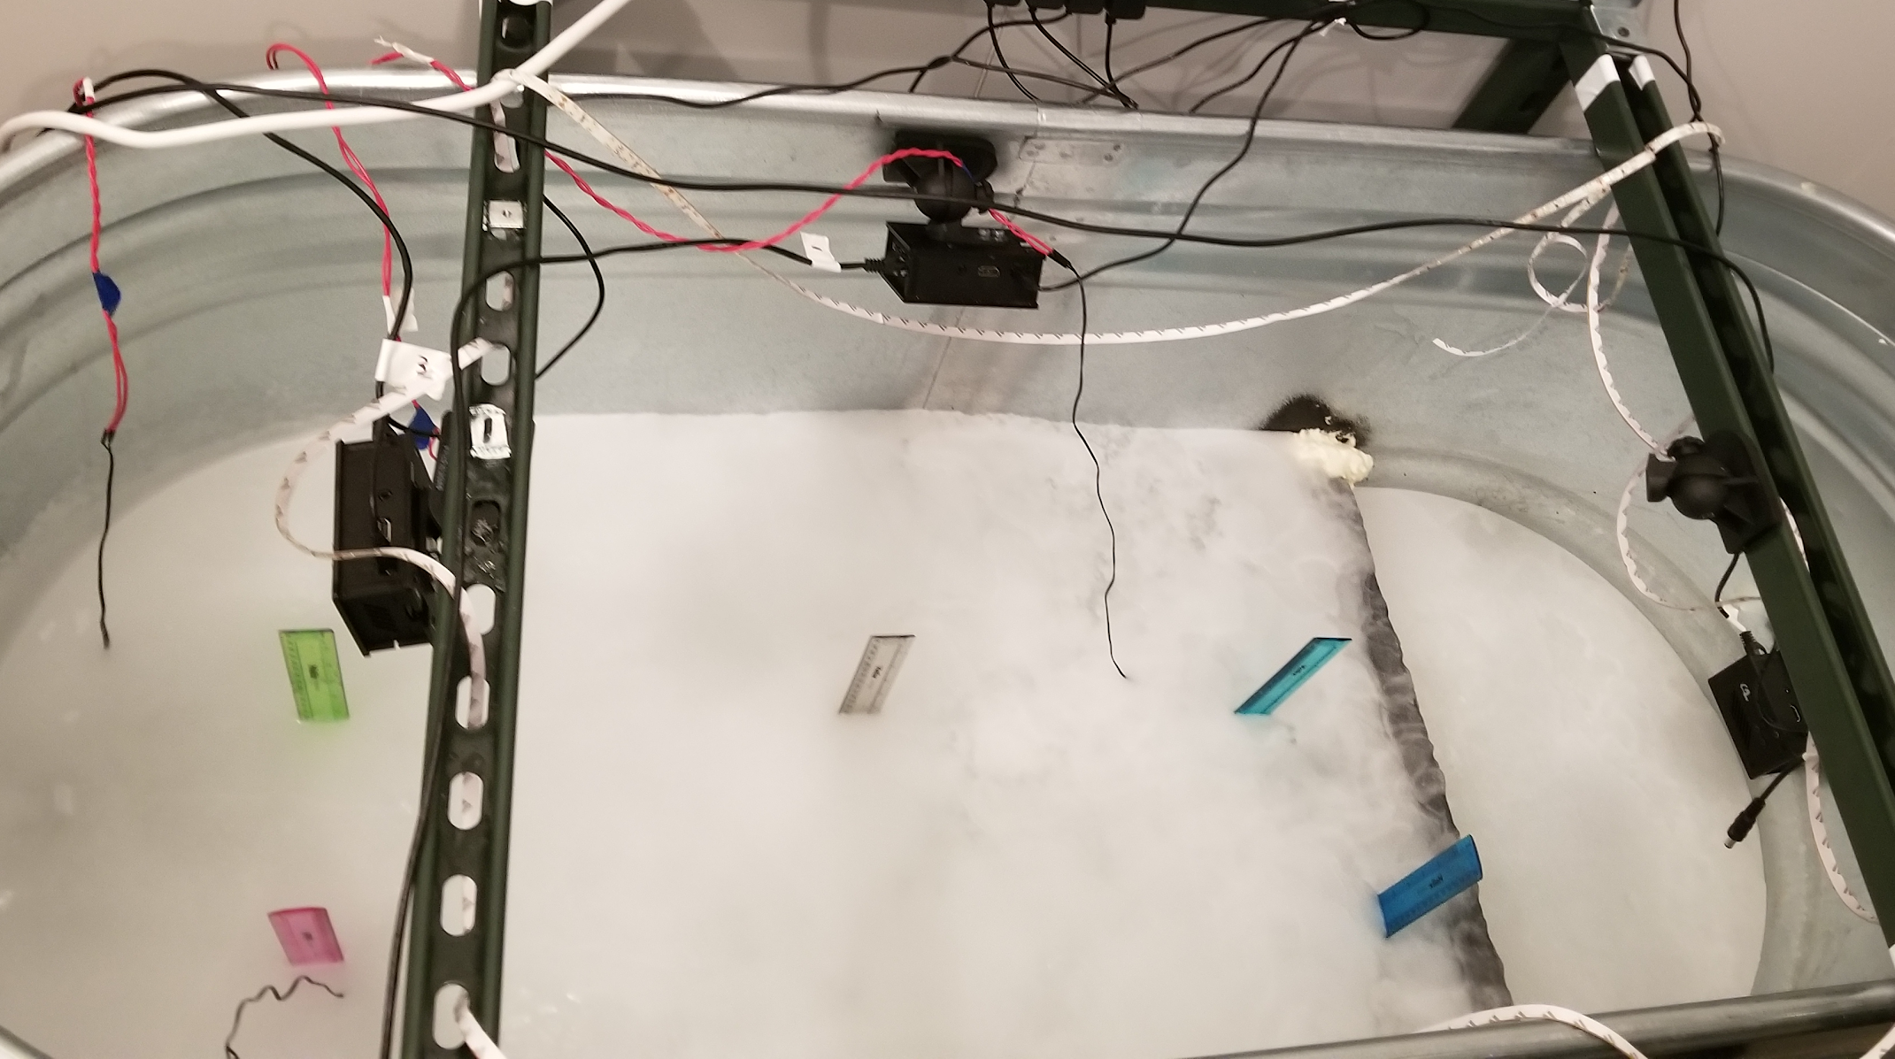
Fresh Water Experiment
Temperature Sensor Placement:
Temperature Sensor | Depth Below Ice Surface (cm)
0 | 5
1 | 7.5
5 | 0.5
0
5
1
Notes:
Experiment Variables:
Flush Frequency: 1 hour
Flush Water volume: 1 liter
Mass flow rate: 0.02 kg/s

Slide 6
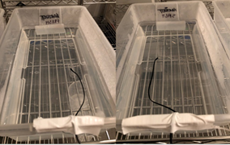
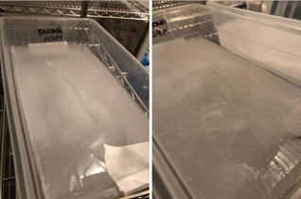
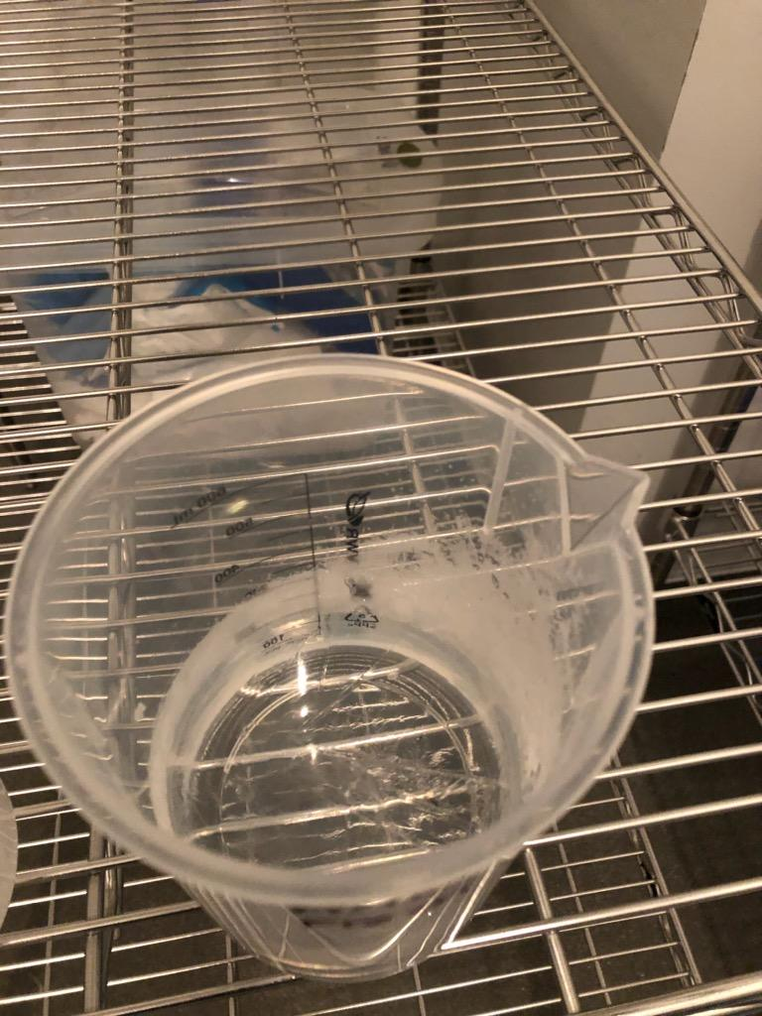
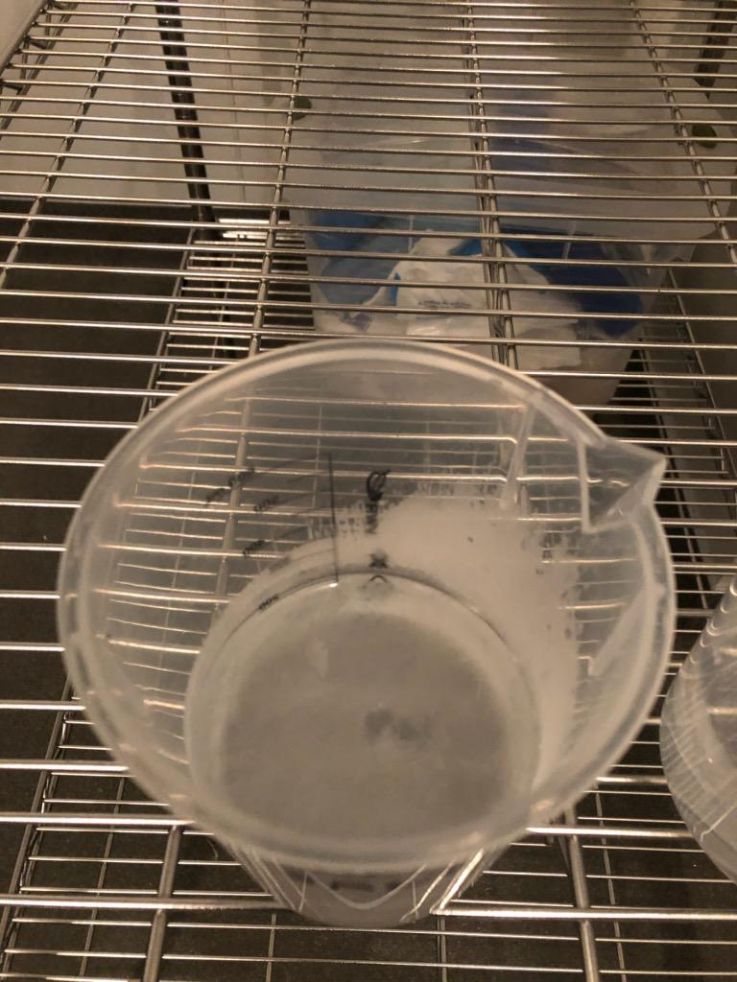
Salt Water Experiments
Results:
Fresh water freezes faster
Salt water freezes in slush form
Freezing temperature
  Fresh water: -0.01°C
  Salt water: -2.4°C
Salt water
Fresh water
Salt water
Fresh water
Notes:
Set up
Temperature sensor results
What does the temperature change for the ice block mean?
Individual sensors?
Check for patterns in the sensor data
Absolute difference over time
Slope in all sensors
How much warming exists in the ice block?
Somehow it looks like the flushed water cools over the experiment
Ice block warms but not uniformly. Why?
What is the difference between the fresh and salt water data

Slide 7
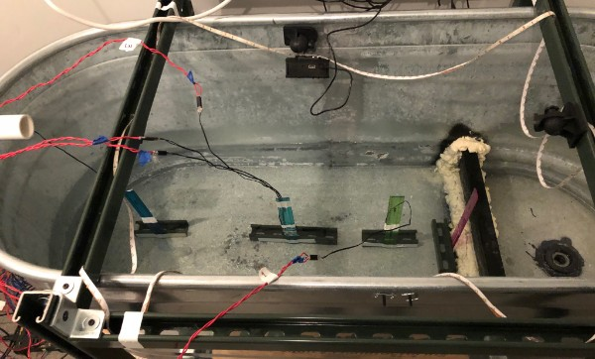
Salt Water Flush Experiment Set-up
Experiment Variables:
  Flush Frequency: 1 hour
  Flush Water volume: 1 liter
One flush per hour for eight hours
Temperature Sensor | Depth Below Ice Surface (cm)
0 | 0.5
1 | 0.5
3 | 7.5
4 | 5
5 | 0.5
0
5
4
3
1

Slide 8
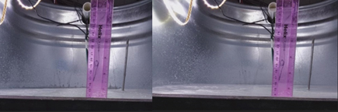
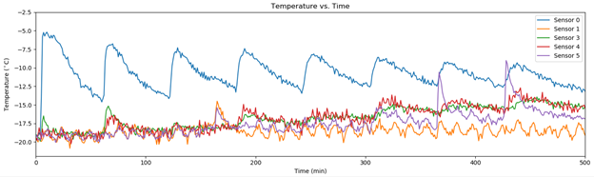
Salt Water Flushing Results
Before Experiment
After Experiment
Temperature vs. Time

Slide 9
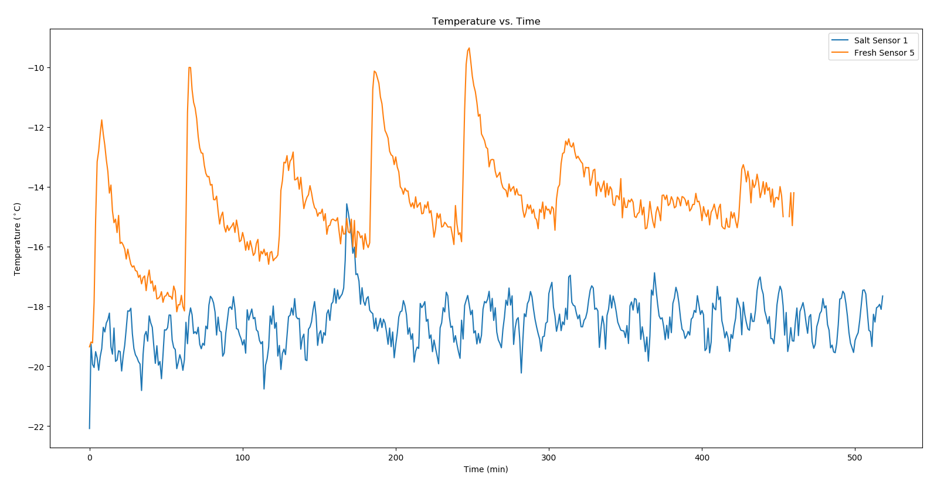
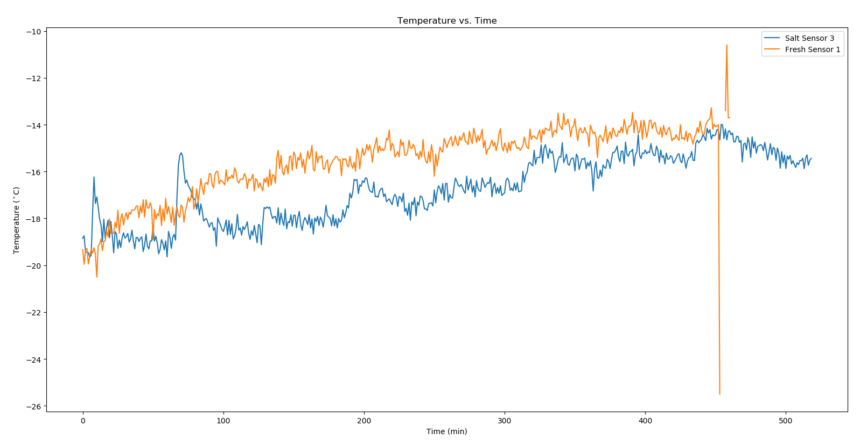
Fresh Water vs. Salt Water Results
Sensors 0.5cm Below Ice Surface
Sensors 7.5cm Below Ice Surface
Fresh water ice sheet returns to equilibrium sooner than saltwater
Salt water stays colder overtime
Notes:
Not a good comparison
Salt water had a big crack

Slide 10
Future Work
Change flush frequency
Flush greater volumes of water
Investigate damage to ice sheet due to water delivery
Notes:
How does ice in pipe affect mass flow rate

Slide 11
Thank you!
Questions?

